Slide 1

TRANSITION SLIDE (White on Maroon)

Slide 2

Transfer Students in Computer Science: Examining Barriers, Success Metrics, and Research Gaps
Nawar Wali & Dr. Sara Hooshangi
Proceedings of the 30th ACM Conference on Innovation and Technology in Computer Science Education V. 1

Slide 3



Why Focus on Transfer Students?
Advance Equity and Success in CS
CS Students are Understudied in Transfer Research
Gap in Understanding from a Global Perspective
Notes:
Diversity in computer science remains a pressing concern, with ongoing debates surrounding the effectiveness of Diversity, Equity, and Inclusion (DEI) initiatives across institutions.
Transfer students often represent historically underserved demographics, including low-income, first-generation, rural, and minority populations.
Supporting these students effectively could unlock the inclusive potential of community colleges and contribute meaningfully to a more diverse computer science community.
Despite well-documented challenges faced by transfer students in STEM, such as financial barriers, ‘transfer shock,’ low retention, and insufficient support, there is a clear lack of research focused specifically on computer science transfer students.
This gap is especially critical because computer science presents distinct academic and professional challenges not fully captured by studies of broader STEM fields.
Addressing this research gap requires a systematic understanding of the unique experiences of CS transfer students to inform targeted interventions.
Most existing CS transfer literature is U.S.-centric, leaving a gap in understanding from a global perspective.
The goal of this literature review is to synthesize existing research, highlight unresolved challenges, and identify actionable opportunities to better support transfer students in CS.
Canada: 2+2
Australia: Tafe
UK: Higher National Diploma to Degree
New Zealand Polytechnics and Institutes of Technology to University
Japan Junior colleges (短期大学, tanki daigaku) to full universities.
S. Korea Junior Colleges (전문대학) to Universities (대학교) – 3rd year transfer exam
Singapore
Malaysia
China
Phillippines

Slide 4

Methodology
Exclusion & Inclusion Criteria
Dataset Curation
Research Questions
Paper Coding
Kitchenham et. al Systematic Literature Review
Notes:
To address this gap, we conducted a systematic literature review using the well-established Kitchenham methodology, adapted from software engineering. This process included defining research questions, developing a protocol, and conducting a multi-stage review of the literature.
We focused on academic and institutional factors affecting CS transfer students, essentially, we asked: What strategies support their success? And where do they still face obstacles?”

Slide 5
Research Questions
Transfer Pathways and Success Metrics
RQ1: What frameworks and institutional strategies best support successful transfer from two- to four-year CS programs?
RQ2: How can these strategies mitigate challenges like GPA shock, retention, and academic performance?
Equity and Diversity in Transfer Pathways
RQ1: How do transfer pathways increase diversity and inclusion in CS?
RQ2: What barriers and support mechanisms affect underrepresented transfer students?
RQ3: How does institutional support shape academic and career outcomes for CS transfer students?
Notes:
“Our research was structured around two main themes.
The first theme is Transfer Pathways and Success Metrics:
What frameworks and institutional strategies support successful transfers?
How can these mitigate issues like GPA drop or retention loss?
And how does support affect career outcomes?
The second theme is Equity and Diversity in Transfer Pathways:
How do CS transfer pathways support underrepresented students?
And what barriers or mechanisms influence their success or attrition?
These questions helped us identify not just what works, but also what’s missing from current support systems.”

Slide 6
Keyword Search Deliberation
Venue Selection: ACM, ASEE, IEEE
Keyword Deliberation: “Transfer Students in Computing‘’, “Transfer Students in Computer Science'' and "Transfer Students in CS".
Final Search String: "Transfer Students in Computer Science" yielded broader results encompassing additional search terms
Notes:
\subsection{Data Sources and Search Strategy}This review focuses on papers from global education- and computer science-related conferences hosted by ACM, IEEE, and ASEE. These venues were chosen to ensure relevance to computing education research while excluding those with broader applications or less direct focuses on computer science education. In addition, accessibility played a crucial part in our decision. Thus, we decided on the three venues for their alignment with computing education, accessibility and representation of high-impact research.
This initial review did not include poster papers or dissertations, which we plan to explore in future iterations. While we recognize that this methodology may exclude some important works, this paper is intended as a foundational step in exploring the academic discourse surrounding computer science transfer students. Future work will aim to expand upon this foundation and address any gaps by incorporating additional methodologies and resources.
\subsubsection{Search Strategy}After selecting the venues of literature, we then conducted a structured keyword search using the methodology to capture literature specifically related to transfer students in computer science.
\textbf{Keyword Deliberation:} A comprehensive list of terms was compiled to represent the intersection of "Transfer Students" and "Computer Science." Key phrases included: ``Transfer Students in Computing'', ``Transfer Students in Computer Science'' and "Transfer Students in CS".
\textbf{Initial Database Search:}The initial search was conducted in the ASEE, IEEE, and ACM digital libraries using combinations of the above keywords.
\textbf{Observation of Prominence:} During our review, we observed that the phrase "Transfer Students in Computer Science" yielded broader results, encompassing papers with additional relevant keywords.

Slide 7
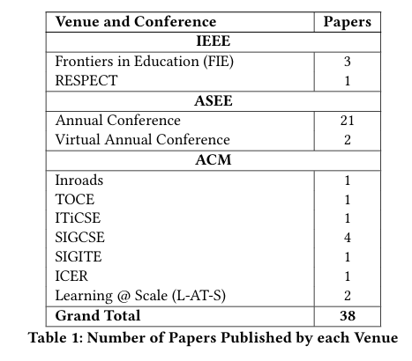
Inclusion & Exclusion Criteria
Dataset Curation
Exclusion criteria: Removed papers with only peripheral mention of transfer students, or those focused on general undergraduate or non-CS populations.
Inclusion criteria: Papers must focus on CS transfer students and address their performance, pathways, or support mechanisms.
We curated 38 papers that met all criteria across the three venues.
Notes:
To answer these questions rigorously, we developed a set of inclusion and exclusion criteria.
We only included peer-reviewed work from high-impact venues such as ACM, IEEE, and ASEE. The papers had to explicitly mention computer science transfer students, not just general STEM populations or university transitions.
This process helped ensure that the findings we synthesized were directly applicable to the unique context of CS.
Here’s a snapshot of our data curation process.
We started with over 500 articles identified through keyword searches. After title and abstract screening, and a full-text review, we were left with 38 papers that fit our criteria.
What stood out immediately was that 37 out of 38 papers were U.S.-based. This confirmed our suspicion that CS transfer research is heavily biased toward U.S. institutions, and that there’s an urgent need for international representation in future work.

Slide 8
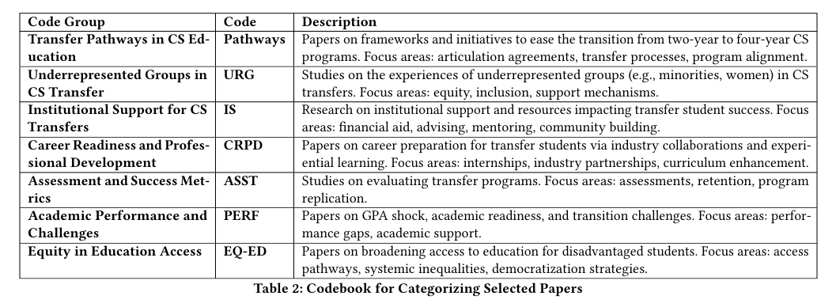
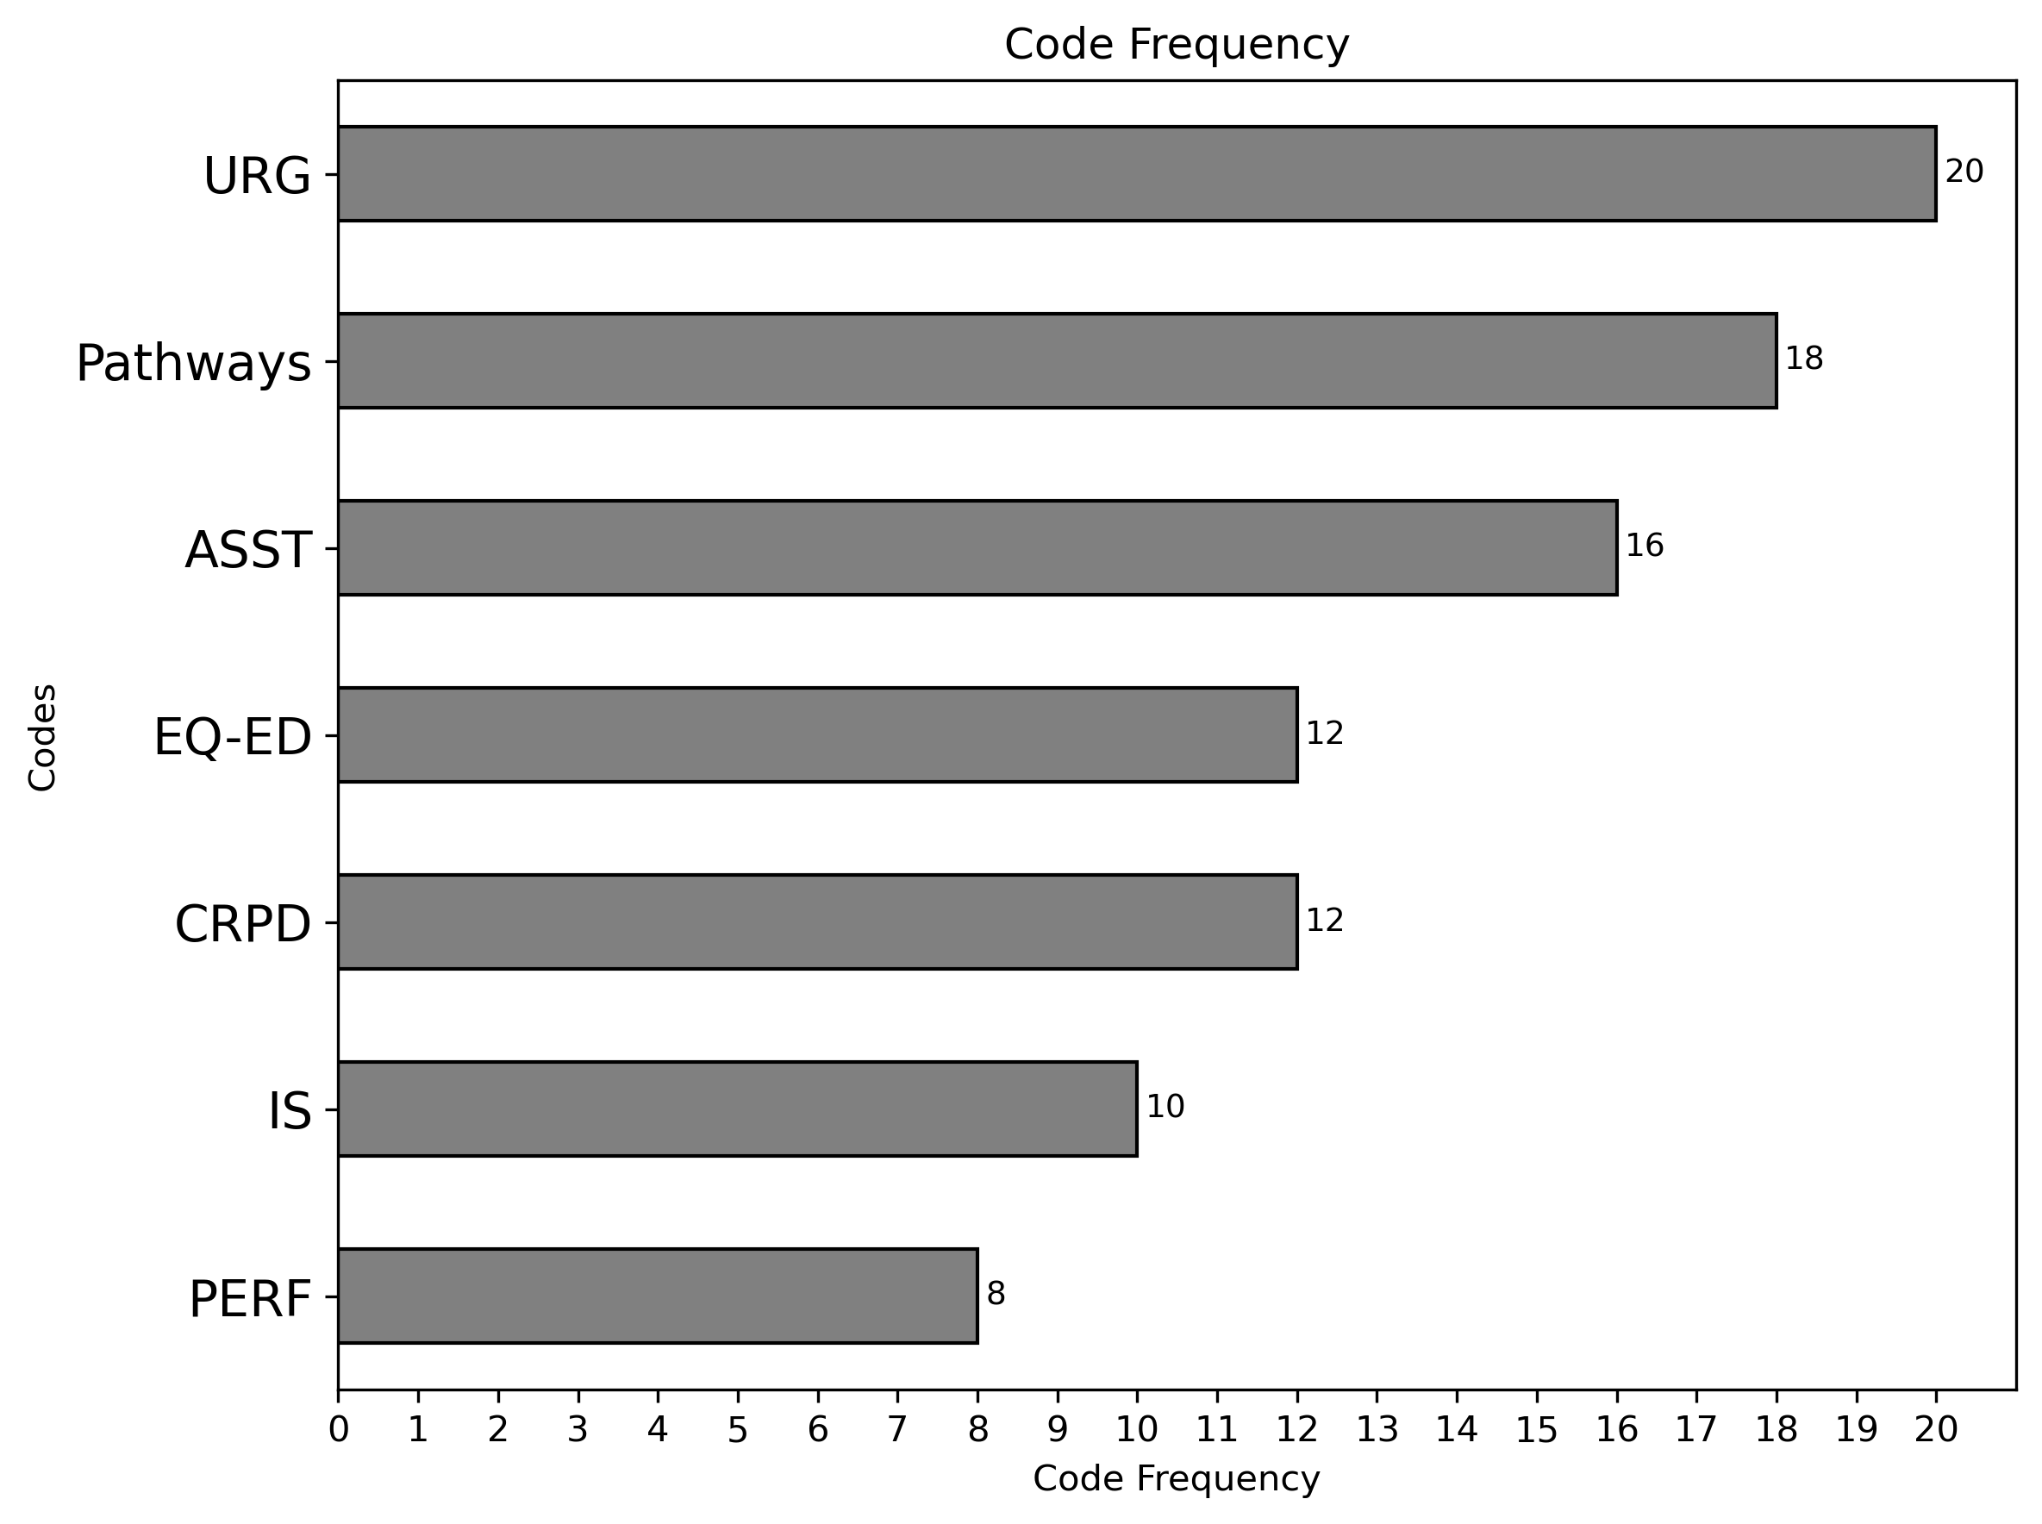
Coding Process & Results
Notes:
We then coded these papers using a combination of deductive and inductive methods. Codes were iteratively refined and applied through three rounds of review, with both authors reaching consensus.
We generated both quantitative summaries, like code frequency,and qualitative insights from themes that emerged. This figure highlights the codes we saw most often, such as academic advising, institutional partnerships, peer support, and financial aid.
We used these codes to organize our findings and group papers based on commonalities

Slide 9




Results – Equity and Diversity Pathways
  National surveys reveal that transfer students are more diverse than native CS students but receive less peer and institutional support.
  Community colleges act as critical access points for underrepresented students entering four-year CS programs.
Outreach at the community college level is essential, many women and minorities choose CS only after enrolling in CCs.
Transfer students are often first-generation, older, and from lower-income households, with proximity to home affecting their decisions.
Notes:
National surveys and institutional reports consistently showed that CS transfer students are more diverse than native students. They’re more likely to be first-generation, older, or from underrepresented racial and socioeconomic backgrounds. And proximity to home is a major factor in their decision-making,often tied to caregiving or financial responsibilities.
However, despite these unique challenges, transfer students receive less institutional and peer support. Outreach at the community college level is often minimal,even though research shows many women and minority students first consider CS only after enrolling in a community college.
Some initiatives go beyond enrollment, focusing on persistence, graduation, and career placement for disadvantaged students.
Summer research programs and hands-on experiences foster graduate school interest and support academic success.
Collaborations with Hispanic-serving institutions emphasize retention strategies tailored to upper-division women transfer students.
National surveys reveal that transfer students are more diverse than native CS students but receive less peer and institutional support.
Community colleges act as critical access points for underrepresented students entering four-year CS programs.
Transfer students are often first-generation, older, and from lower-income households, with proximity to home affecting their decisions.
NSF-funded programs have directed scholarships and mentorship to URM students and those with high financial need.
Outreach at the community college level is essential, many women and minorities choose CS only after enrolling in CCs.
Despite high transfer rates, few women choose CS or engineering majors, just 2% vs. 11% of men in a Texas cohort study.

Slide 10





Results - Institutional Support & Barriers
Financial aid is a crucial in retention and their initial decision to transfer.
Collaboration between two- and four-year institutions, significantly improves transfer outcomes.
Mentoring and academic support ease adjustment
Transition challenges affect academic performance
Lower GPA in prerequisites hinders academic preparedness
Early advising, cohorts, and scholarships aid integration
Notes:
We found strong evidence that specific institutional practices improve transfer outcomes:
Early advising tailored to CS curriculum
Transfer-specific cohorts
Tutoring and bridge programs for high-fail courses like Data Structures
And most importantly, transparent financial aid and scholarship pipelines.
However these supports are not universally implemented. Many CS transfer students still experience what’s called ‘GPA shock’,a significant drop in academic performance post-transfer. Much of this stems from inconsistent credit articulation and lack of preparation for rigorous upper-level CS coursework.
Transfer Pathways and Success Metrics
Financial aid is a crucial factor in both the retention of CS transfer students and their initial decision to transfer.
Collaboration between two- and four-year institutions, including articulation agreements and program alignment, significantly improves transfer outcomes.
Programs offering mentoring, orientation, tutoring, and academic advising help students adjust to new academic environments.
Academic preparedness remains a major barrier, students with lower GPAs in prerequisite courses often struggle in follow-up CS courses.
Summer bridge and mandatory tutoring programs have shown strong results, especially in subjects like mathematics.
Early advising, cohort-based models, and scholarships contribute to academic and social integration.
Near-peer mentorship, such as NSF S-STEM-supported mentoring, provides emotional, academic, and career guidance.
Transition challenges, such as moving from semester to quarter systems , continue to affect academic performance and adaptation.
Disparities in academic readiness (e.g., BDSI scores) suggest a need for targeted academic interventions.

Slide 11
Discussion
Transfer Pathways and Success Metrics
Transfer pathways are key to diversifying CS programs
Students often lack access to mentoring, peer networks, and tailored support,
CS programs must develop inclusive, equity-centered practices that address their specific needs.
Intersecting barriers, disproportionately affect women and minority transfer students.
Combined academic and professional mentoring help bridge both knowledge and opportunity gaps.
Structural obstacles, must be addressed.
Notes:
“In our discussion, we find that Many challenges identified for CS transfer students mirror broader STEM trends, but CS-specific issues like credit articulation and data structures preparation are underrecognized.
Mentorship and community-building remain two of the most effective strategies across both academic and equity-based outcomes.
Institutions should prioritize building intentional support pipelines, combining academic guidance, financial aid, and inclusive engagement practices.
Future research and program design must be intersectional and equity-driven, with sensitivity to the lived realities of diverse transfer student populations.

Slide 12


Conclusion
Addressing transfer student barriers requires a multi-faceted strategy combining financial aid, academic preparation, and inclusive community support.
Many challenges identified for CS transfer students mirror broader STEM trends, but CS-specific issues like credit articulation and data structures preparation are underrecognized.
Notes:
Addressing transfer student barriers requires a multi-faceted strategy combining financial aid, academic preparation, and inclusive community support.
Institutions must collaborate to create streamlined, equitable transfer pathways that are transparent and outcomes-oriented.
Many challenges identified for CS transfer students mirror broader STEM trends, but CS-specific issues like credit articulation and data structures preparation are underrecognized.
This review lays the groundwork for more comprehensive studies focused specifically on CS transfer students, beyond general STEM trends.

Slide 13
Limitations
Future Work
While we focused on high-impact conferences (ACM, IEEE, ASEE), we acknowledge the need to include posters, and different perspectives in future reviews.
Our search strategy may have missed studies using alternative terminology (e.g., informatics or software engineering), which future work will aim to capture.
Moving forward, we will include curriculum alignment analyses and work to differentiate CS-specific findings from generalizable STEM insights.
The ultimate goal is to generate evidence-based recommendations that improve both access and success for CS transfer students worldwide.
Notes:
We focused on English-language papers in high-impact conferences, which means we likely missed insights from journals, posters, and international work. Also, our keyword strategy may have excluded relevant studies labeled under 'informatics' or 'software engineering.'
In future work, we plan to expand our search terms and include a broader array of publication types.
Moving forward, we will include curriculum alignment analyses and work to differentiate CS-specific findings from generalizable STEM insights and focus on international perspectives
The ultimate goal is to generate evidence-based recommendations that improve both access and success for CS transfer students worldwide.

Slide 14
Connect with us: nawarwali@vt.edu shoosh@vt.edu

